Slide 1
Cognitive: Discovery Gary Wilson Technical Leader & CTO, UKI Commercial Business

Slide 2


Objective
Extend your chatbot to handle long tail conversations
Watson Conversation
Watson Discovery
Node-RED
Telegram
Watson
Conversation
Here Watson uses reasoning strategies that focus on the language and context of the question.
Help me pick a phone
Frequency of Questions
My LG D800 is grinding to a halt, what can I do?
Watson Discovery
Here Watson uses reasoning strategies that focus on identifying the most appropriate answer.
Short Tail
Long Tail
100s
100,000+
Unique Intents

Slide 3
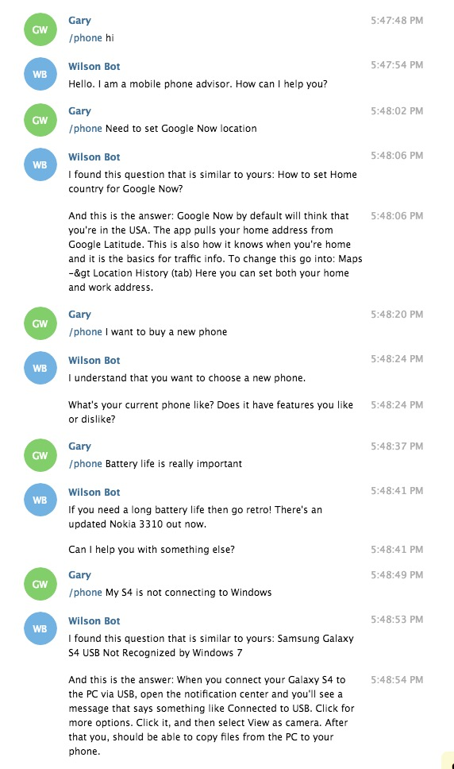
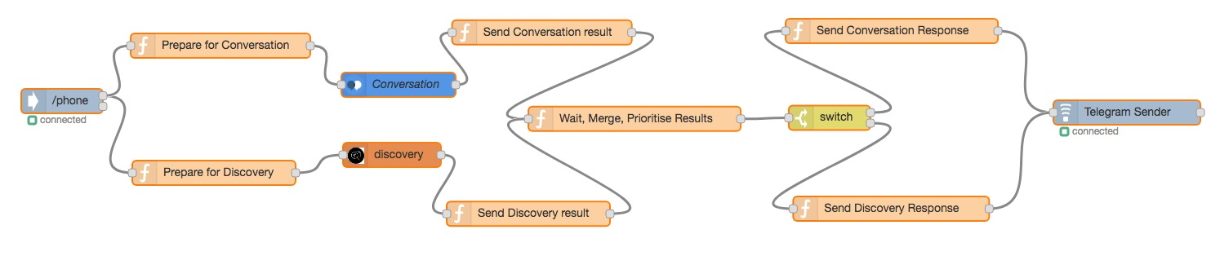
Objective

Slide 4



Agenda
setup Telegram chatbot
setup Discovery Service instance
setup Discovery document collection
build Discovery Q&A knowledge base
setup Node-RED orchestration application
query Discovery through Bot
connect Discovery and Conversation

Slide 5
What is the Discovery service?
a cognitive search and content analytics engine
helps rapidly build cognitive, cloud-based applications that unlock insights hidden in unstructured data
includes proprietary data, and public and third-party data
Basic terms
Collection Document Query
Notes:
- Discovery INGESTS your data, converting it and allowing you
to enrich it using NLP metadata
- It then STORES it as a collection, for use by your apps ...
- ... Which can QUERY it and provide INSIGHTS
- In the lab we'll use a set of 1000 Q&A pairs that help a
mobile phone user answer specific support-type questions

Slide 6
Collections and documents
Collection = set of documents
Documents = JSON, DOC, HTML, PDF
contain data of potential use to an application
e.g. Q&A pairs for use by chatbot
Documents in your collection are converted using a configuration file you specify
Watson Discovery can enrich (add cognitive metadata to) ingested documents with semantic information collected by seven Watson functions
Entity Extraction, Sentiment Analysis, Category Classification, Concept Tagging, Keyword Extraction, Emotion Analysis and Semantic Role Extraction

Slide 7
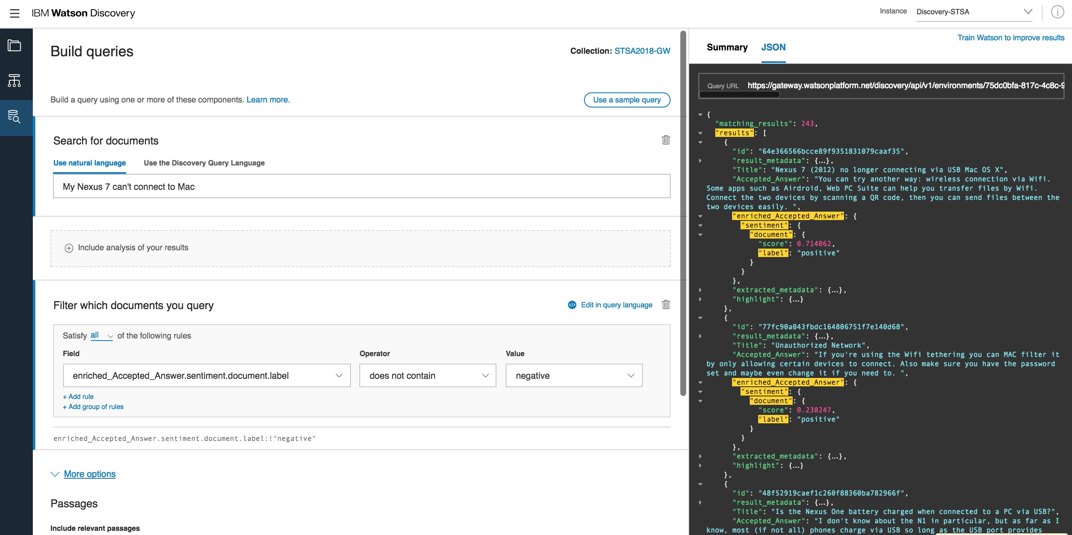
Queries
Watson Discovery offers powerful content search capabilities
once content is uploaded and enriched by the Discovery service, you can build queries, and
integrate Discovery into your own applications
create custom applications using the Watson Explorer Application Builder
Notes:
- You can use the Watson Discovery Query service to test and refine the quality of responses Watson provides

Slide 8
Cognitive: Discovery Gary Wilson Technical Leader & CTO, UKI Commercial Business

